Slide 1
Syntax
Lecture 7

Slide 2
Contents
1. linguistic elements combined to form sentences
constituents and constituency tests
categories of the constituents
2. rules underlying sentences
-- phrase structure rules
-- lexical rules

Slide 3
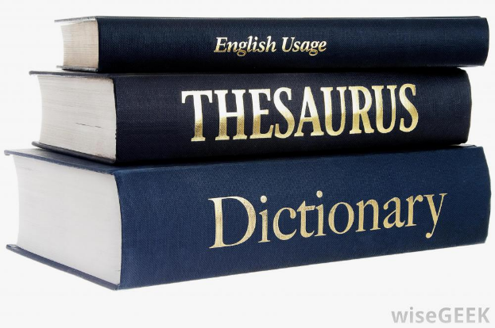
Normally, a speaker can produce and understand an infinite number of sentences.
children
BUT, a speaker does not need to store all those sentences in memory.
not feasible

Slide 4
What does a speaker store in mind?
a limited set of words
a limited set of rules for combining these words
Speakers combine linguistic elements in a rule-governed way.

Slide 5
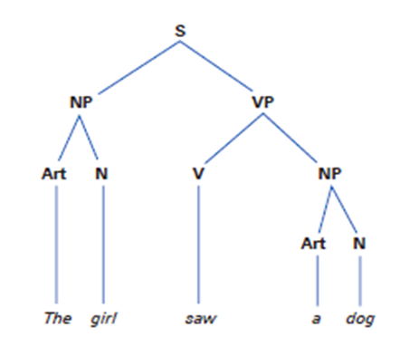
Constituents
A sentence is composed of different subparts (words, groups of words).
Constituents
Not all sequences of words function as constituents.
The child found a puppy.

Slide 6
Constituency tests
How can we know some sequences of words are constituents while others are not in a sentence?
moveable, replaceable, standing alone, …

Slide 7
Constituency Tests
1. “move as a unit” test
If a group of words can move, they form a constituent.
The child found a puppy.
Cleft: ‘It is/was … that ... ’
fronting:
Passive: “… be done by …”
…

Slide 8
Constituency Tests
2. “replacement/substitution” test
If a group of words can be replaced by a pronoun/ do/so/as/…, they form a constituent.
The child found a puppy in the park.

Slide 9
Constituency Tests
A pronoun cannot be used to refer back to something that is not a constituent:
John asked me to put the clothes in the cupboard.
the clothes?
in the cupboard?
put the clothes?

Slide 10
Constituency Tests
3. “stand-alone” test
If a group of words can stand alone, they form a constituent.
The professor met several former students at the conference.

Slide 11
Constituency Tests
a. John looked [up the inside of the chimney].
b. John looked [up the meaning of ‘chanson’].

Slide 12
Constituency Tests
And some other constituency tests… [e.g., coordination test]
Passing one test is sufficient to determine constituency.
Normally, failing all these tests is a requirement for determining non-constituency

Slide 13
Constituents
Constituency is determined with respect to a particular sentence.
The girl [saw a dog].
The girl [saw a dog] barking.

Slide 14
Categories of constituents
Words: Noun, Verb, Preposition, Adjective, Adverb, Auxiliary, Conjunction, and Determiner
Constituents: NP, VP, PP, AdjP, AdvP (Phrasal categories)

Slide 15
Rules
Phrase structure rules（generating structures）
-- rules governing the formation of constituents
-- rules governing the formation of sentences
Lexical rules (specifying which words can be used )
-- rules that can turn the structures into recognizable words or phrases

Slide 16
Lexical rules
Det → {a, the, this, my, each,…}
N → {girl, dog, boy, Mary, students, …}
V → {followed, helped, saw, ran, sang, …}
Adj → {happy, uncomfortable, terrified, sad, …}
Adv → {soundly, well, clearly, extremely, …}
P → {from, in, on, with, under, …}
…

Slide 17
Phrase Structure Rules
A phrase structure rule tell us two things:
1) what elements go into a phrase/sentence
2) the order of the elements
S → NP VP
NP → (Det) (Adj) N (PP/S)
VP → V (NP) (Adv/PP/S)
…

Slide 18
Phrase Structure Rules
________ liked ice cream.
Mary, I, you, students, the students, the tall students, the students from Seoul, the students who came from Seoul, etc.
NP → (Det) (Adj) N (PP/S)

Slide 19
Phrase Structure Rules
The student ________.
a. ran, sang loudly, loved music, walked the dog through the park, thought Tom is honest, warned us that storms were coming...
b. can run, will feel happy, must study English syntax, . . .
VP → V (NP) (Adv/PP/S)
VP → V[AUX +] VP

Slide 20
Phrase Structure Rules
John feels ________.
happy, uncomfortable, terrified, sad, proud of her, proud to be his student, proud that he passed the exam, etc.
AP → Adj (PP/VP/S)

Slide 21
Phrase Structure Rules
a. He behaved very _________.
b. They worded the sentence very _________.
c. He treated her very _________.
soundly, well, clearly, extremely, carefully, very soundly, almost certainly, very slowly, etc.
AdvP → (AdvP) Adv

Slide 22
Phrase Structure Rules
from Seoul, in the box, in the hotel, into the soup, with John and his dog, under the table, etc.
PP → P NP

Slide 23
Phrase Structure Rules
Rules governing the formation of sentences
a. This handsome man chased a dog.
b. A man kicked that ball.
c. Ryan asked for a beer.
d. Ryan begged beer from his dog.
S → NP VP

Slide 24
Reading materials for next week
Chapter 9 Semantics

